Slide 1

Chevron Corporation Analysis
Statistics for Data Analysts
PRESENTED BY : Anitha Kurup, Keya Keya, Olivia Belinda Dsa, Richa Gupta

Slide 2
Content
About Chevron Corporation
Fama-French Model
Data Analysis
Scatter Plot
Model Creation and Analysis
Model Interpretation and Inferences
Hypothesis Testing
Validity of Model
Conclusion

Slide 3
About Chevron Corporation
Headquartered in San Ramon, CA
Second largest energy company
Mission is to develop affordable, reliable, ever-cleaner energy that enables human progress
This quarter’s sales forecast is in the range of $40.80B to $55.08B
Notes:
Chevron Corporation is a multinational energy company headquartered in San Ramon, California, USA.
It is one of the largest integrated energy companies in the world, engaged in every aspect of the oil, gas, and geothermal energy industries, including exploration, production, refining, marketing, and transportation.

Slide 4
Fama French Model
Statistical Model designed in 1992
Three factors are:
1. Market Access Return
2. The outperformance of small versus big companies
3. The outperformance of high book/market versus low book/market companies
Model explains over 90% of the diversified portfolios returns
Notes:
Market access, or "HML" in the Fama-French three-factor model, is one of the three factors used to explain the variation in stock returns.
The outperformance of small versus big companies in the Fama-French model is captured by the SMB factor, This factor is one of the three factors used in the Fama-French three-factor model to explain the cross-sectional variation in stock returns.
The outperformance of high book-to-market (value) versus low book-to-market (growth) companies in the Fama-French model is captured by the HML factor, which represents the excess return of a portfolio of high book-to-market stocks over a portfolio of low book-to-market stocks. This factor is one of the three factors used in the Fama-French three-factor model to explain the cross-sectional variation in stock returns.

Slide 5
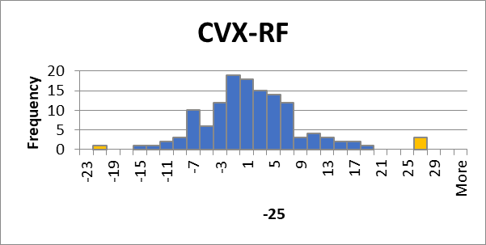
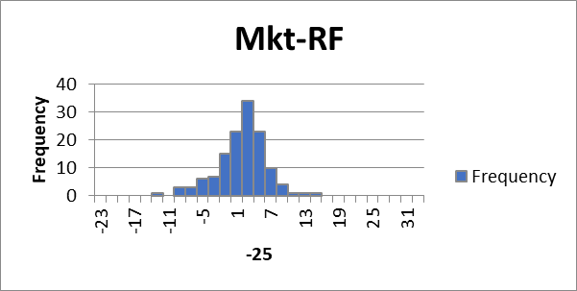
Data Analysis
This bell-shaped histogram with one peak
Normally distributed with a clustered distribution around the mean.
The 29 bins are 2 units wide so as to clearly indicate outliers in the graph
Highest CVX frequency recorded is 19 in the bin -1 and there are 5 outliers
The standard deviation of CVX data is 7.5254
A skewness value of CVX of 0.62113 indicates that the distribution of the data is slightly skewed to the right, but not strongly skewed.
A skewness value of Mkt of -0.4423 indicates that the distribution of the data is slightly skewed to the left with a longer left tail.
Notes:
Histograms are great tools to represent and reveal properties of data. It is a graphical representation of the distribution of a dataset, with the x-axis representing the range of values and the y-axis representing the frequency.
We have produced two different histograms to compare the excess returns of CVX and MKT-RF. In order to produce both the histograms, we have set the bin width to 2.
Outliers are values that lie 1.5 points or more away from the majority of other values in the cluster.
The Highest CVX frequency recorded is 19 in the -1 percentage of CVX stock return

Slide 6
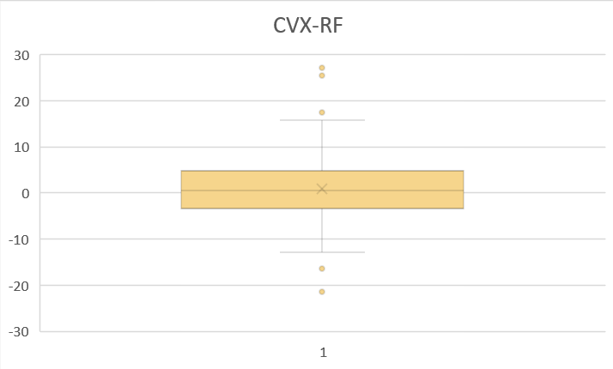
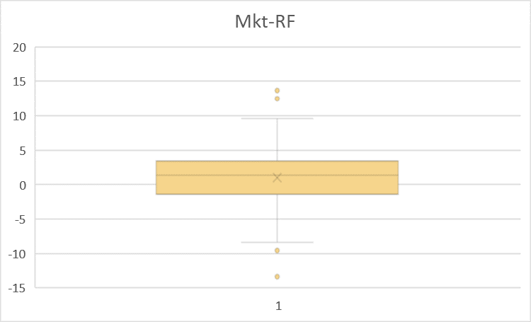
Data Analysis
The median is 0.48418 and is near the center of the box for CVX and it is 1.36
For Mkt.
The narrow box indicates a smaller spread
CVX First quartile = -3.48223
CVX Second quartile = 4.588305
CVX boxplot clearly indicates the presence of 5 outliers while Mkt has 4.
Notes:
Box plots are a useful tool in statistics for summarizing and visualizing the distribution of a dataset.
In statistical analysis, box plots can be used in hypothesis testing, and can also be used in regression analysis.

Slide 7
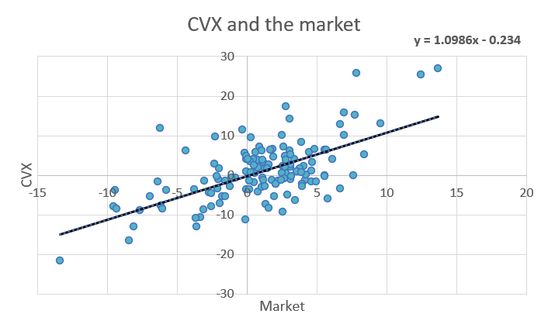
Scatter Plot
This scatterplot presents the relationship of the market and the stock CVX
The scatterplots regression line shows a positive correlation between the two variables
Most of the data point are concentrated around the regression line but there are 5 or more outliers
The correlation coefficient is 0.632433, a moderately positive correlation between CVX and the market
y = 1.0986x - 0.234

Slide 8

Scatter Plot
Because the coefficient of determination represents the proportion of the variants in the dependent variable - CVX stock- that is explained by the independent variable - Market. Since the value of the coefficient is closer to 0, it indicates the impact of the market on CVX is low.

Slide 9
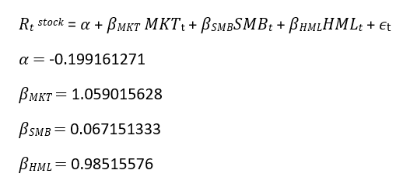
Linear Model
The random error is centered around 0 with a standard deviation of 4.8293
Notes:
Using Excel's Regression analysis from Data Analysis tools and including 99% confidence intervals for the coefficient estimates, we found the y-intercept and the coefficients of each Fama-French Factors. Then, the following linear factor model was built
which is a mathematical equation that describes the linear relationship between a dependent variable and one or more independent variables. It is a type of regression analysis used to analyze the relationship between variables, and is often used to make predictions based on the data.
Here’s our linear model
Equation from the slide
Y = β0 + β1X1 + β2X2 + ... + βnXn + ε
Where:
Rtstock is the dependent variable (also called the response variable)
alpha is the intercept (the value of Y when all the X variables are equal to zero)
βmkt, βsmb, ..., βhml are the coefficients of the independent variables Mkt, smb, hml, respectively
ε is the random error term, which accounts for the variation in Rtstock that is not explained by the independent variables.
So with other variables constant for every change in Mkt by 1.05% the stock price increases by 1%

Slide 10
Model Creation and Analysis
Understanding Factor coefficients and relationships
Factors | Coefficients | Lower 99% | Upper 99% | T-stat | P-value
Intercept | -0.1991613 | - | - | - | -
Mkt-RF | 1.05901563 | 0.79467 | 1.3234 | 10.4740 | 5.913x10⁻¹⁹
SMB | 0.0671513 | -0.39212 | 0.5264 | 0.38227 | 0.70289
HML | 0.985156 | 0.66126 | 1.9030 | 7.95209 | 8.062x10⁻¹³
All factors have a positive linear relationship with CVX.
MKT-RF has the most impactful relationship, while SMB has almost no relationship with CVX.
Model Equation: -0.199 + 1.05901(MktRF) + 0.06715(SMB) + 0.98516(HML) + 4.8293
Notes:
Analysis -
Here we calculated the coefficient value with 99% confidence interval and the respective probabilities
Coefficients shows impact each independent variable on dependent variable and p values shows the impact that it will effect the variable
All factors have a positive linear relationship with CVX.
MKT-RF has the most significant relationship, while SMB has almost no relationship with CVX.
T stat measures significance of coefficients

Slide 11
Understanding Model Statistics
Adjusted R² | 0.588178999
Standard Error | 4.829305582
F Significance | 2.2639x10⁻²⁵
Critical T | 2.613300477
The adjusted R2 is 58%. We believe that since this is real world data, and stocks can comprise largely of idiosyncratic volatility, this is a good value.
Our F significance is also very low and points to the model being an overall good model.
Notes:
R-squared represents the measure of goodness of fit for our linear regression model. It indicates the percentage of the variance in the dependent variable that the independent variables explain all
together. R-squared measures the strength of the relationship between our model and the dependent variable which is CVX stock returns.
From our regression model we found that adjusted R-squared is equal to 0.588, and we can say that 58.81% of the variability in the CVX Stock returns can be explained by the regression model.
F significance determines the overall significance of the regression model. It measures the ratio of the explained variance to the unexplained variance in the dependent variable, and assesses whether the regression model as a whole provides a better fit to the data than a model with no independent variables (i.e., a model with only an intercept term).
The F-statistic is calculated as the ratio of the mean square regression (MSR) to the mean square error (MSE). MSR measures the variation in the dependent variable that is explained by the independent variables, while MSE measures the variation that is not explained by the model.
If the F-statistic is large and the associated p-value is small (typically, p < 0.05), this indicates that the regression model as a whole is significant and provides a better fit to the data than a model with no independent variables.
In regression analysis, the critical t-value (also known as the t-critical value) is a threshold value used to determine whether a coefficient estimate is statistically significant. The t-value is calculated by dividing the estimated coefficient by its standard error.

Slide 12
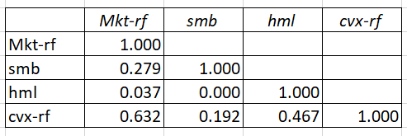
Model Interpretation and Inferences
Tests for multicollinearity
Factor | Variance Inflation Factor (VIF)
Mkt-RF | 1.085853
SMB | 1.084338
HML | 1.001505
Our assumptions from the histogram are validated by the correlation between CVX and MKT.
We also calculated the VIF for factors against RTX to ensure that the correlation does not imply multicollinearity

Slide 13
Regression with two factor models
 | Mkt-RF & SMB | Mkt-RF & HML | HML & SMB
Adjusted R2 | -0.01386 | 0.06359 | 0.064897
F Significance | 0.906861 | 0.00518 | 0.00473
Standard Error | 3.418923 | 2.411157 | 4.189119
Results for Model with SMB and HML as factors
Factors | Coefficients | Lower 99% | Upper 99% | T-stat | P-value
Intercept | 1.032018807 | - | - | - | -
SMB | 0.484535324 | 0.101994 | 0.867077 | 3.31118 | 0.001203
HML | 0.047497722 | -0.23322 | 0.328216 | 0.44232 | 0.658992

Slide 14
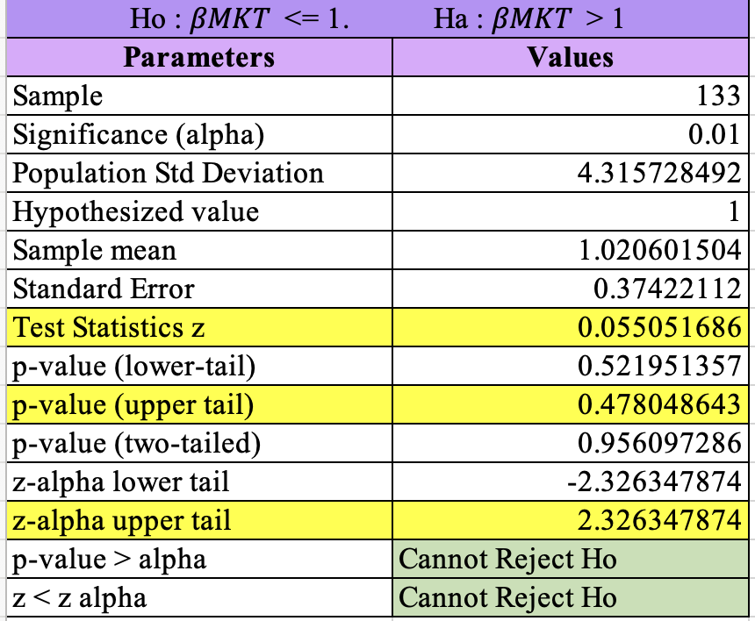
Hypothesis Testing
Rejection Rule: p-value approach
[Cannot reject Ho as p-value > alpha]
Critical value approach
[Cannot reject Ho as Z < Z-alpha]
Also, the coefficient of MKT from our linear model is 1.05901
This restates that the null hypothesis cannot be rejected.
Notes:
Hypothesis testing:
We performed Null hypothesis for 𝛽𝑀𝐾𝑇 and 𝛼.
𝛽𝑀𝐾𝑇
The Null Hypothesis Ho : 𝛽𝑀𝐾𝑇 < = 1 while the alternative hypothesis Ha : 𝛽𝑀𝐾𝑇 >1 with a significance of 1%
With all the parameters required, we calculated the Test statistics z, the p-values and z-alpha to test both the rejection rules approaches.
P-value approach states to reject the null hypothesis when p-value < alpha.
However,
P-value =0.478
Alpha = 0.01
And as p-value > alpha, we cannot reject the null hypothesis.
Similar result is obtained from Critical-value approach, where z < z-alpha and again the null hypothesis cannot be rejected.
Thus, the null hypothesis that 𝛽𝑀𝐾𝑇 < = 1 also makes sense as the 𝛽𝑀𝐾𝑇 from our linear factor model is 1.05901 (equal to 1).

Slide 15
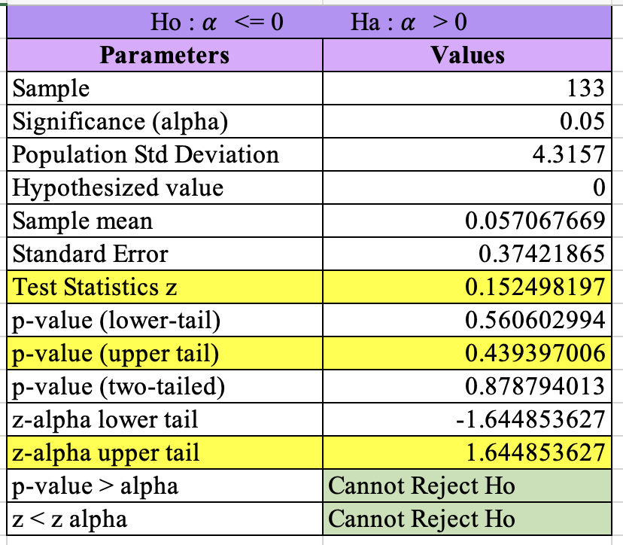
Hypothesis Testing
Rejection rule: p-value approach
[reject Ho if p-value <= alpha]
Again, we cannot reject the Ho as the p-value of the upper tail is greater than the alpha stated for the model testing.
Critical value approach
[reject Ho if Z >Z alpha]
However, the Z < Z alpha here which again concludes that the Ho cannot be rejected.
𝛼 from linear factor model is also -0.199 (< 0), backing up the null hypothesis.
According to Fama-French model we can conclude that there isn’t sufficient evidence which proves that the stocks are positively impacted by the SMB, HML and Mkt-RF.
Notes:
𝛼
The Null Hypothesis Ho : 𝛼 < = 0 while the alternative hypothesis Ha : 𝛼 >0 with a significance of 5%
With all the parameters required, we calculated the Test statistics z, the p-values and z-alpha to test both the rejection rules approaches.
P-value approach states to reject the null hypothesis when p-value < alpha.
However,
P-value =0.439
Alpha = 0.05
And as p-value > alpha, we cannot reject the null hypothesis.
Similar result is obtained from Critical-value approach, where z < z-alpha and again the null hypothesis cannot be rejected.
From linear factor model
𝛼 = -0.199
Reinstating 𝛼 < = 0.

Slide 16
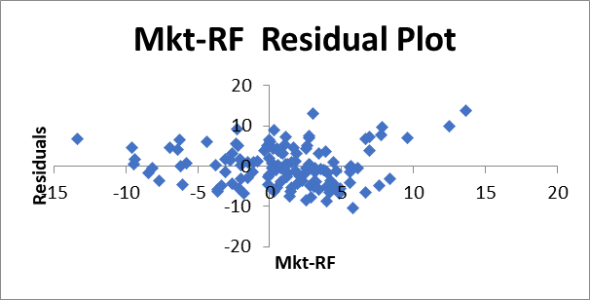
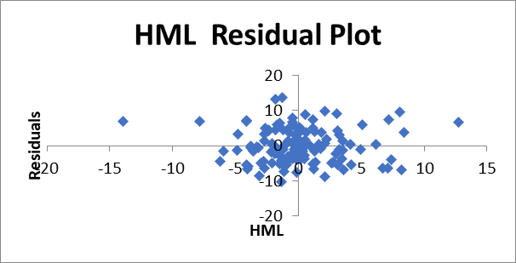
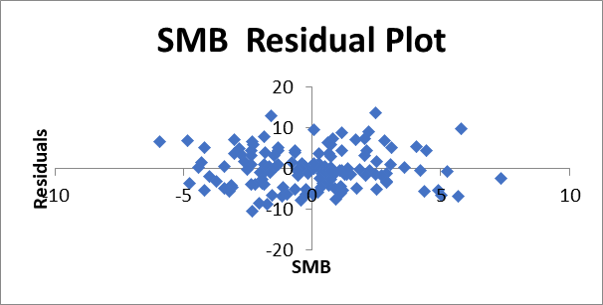
Validity of the model
All residuals follow an even distribution, barring a few outliers.
Symmetric about the origin
High density of data distribution around the origin, and lower density further away from the origin.
Notes:
Validity of the model
All plotted residuals are symmetric about the origin with few random outliers.The origin is densely populated while lower density a further away the origin.

Slide 17
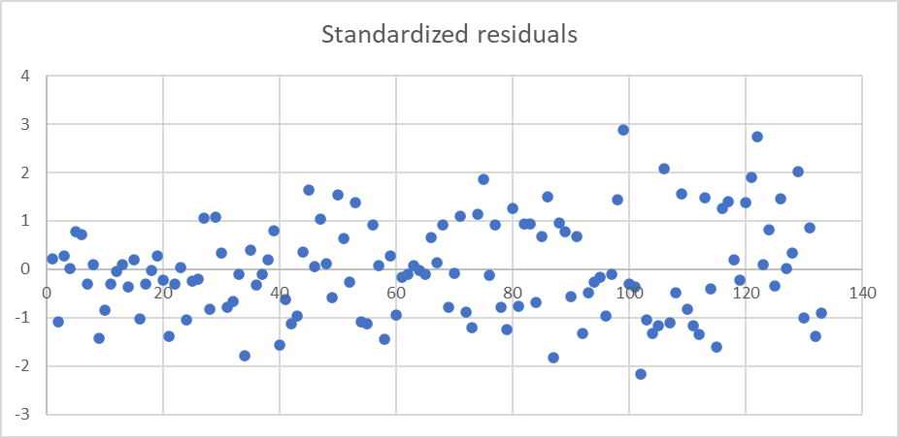
Validity of the model
Points follow a even,highly dense distribution around the X-axis.
The majority of the values between -2 to +2 .
Few outliers (5),but well within the expected range of outliers out of 133 data observations ,thus 3.76%
Another observation is the spread of the data increases as you move along the x-axis
Notes:
The standardized residual plot conveys that the majority of the values fall between -2 to +2 and more densely populated near the 0 region. Which denotes that there are very few outliers, constituting to 5 out of the 133 data observations in total (3.76%).

Slide 18
Conclusion
Based on our analysis of the model, all tests point to a valid model. However, its poor relationship with SMB puts the model into doubt. Retaining SMB might be an approach moving forward since the removal of SMB results in bad model results as showcased previously. It is a good fit but outliers cannot be neglected
Nevertheless, an alternative must be found to the removal of SMB since its removal creates an invalid model.
Moreover, the model is made under the assumption that residual values are normally distributed.
If the error term values do not follow a normal distribution then the validity of the model generated is questionable.

